Slide 1
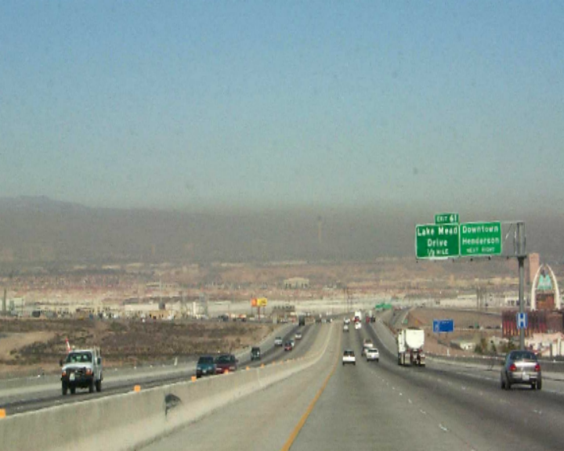
The Las Vegas Valley Visibility and PM_{2.5} Study
Dr. Mark Green
Division of Atmospheric Sciences
Desert Research Institute
University and Community College System of Nevada
Las Vegas, NV

Slide 2
Current, previous visibility related work
PhD in Atmospheric Sciences- dissertation on transport of visibility reducing particles
Design and management for large regional visibility studies in SW US (Project MOHAVE), Texas (BRAVO) and Pacific Northwest (Columbia River Gorge AQ Study)
Member Grand Canyon Visibility Transport Commission Meteorology committee – prepared Clean Air Corridor analysis
Vice-Chair AWMA visibility committee
At DRI Las Vegas office since 1990

Slide 3
Why Study Visibility & PM2.5?
Visibility reduction (Haze) is most apparent aspect of air pollution
Haze muddies or obscures scenic views such as of our mountains and the Las Vegas strip
Clean Air Act requires “natural background” conditions at Class I areas (mainly national parks and wilderness areas) such as Zion, Bryce Canyon, Grand Canyon- regional haze regulations require states to make progress toward this goal
PM2.5 (especially diesel exhaust) linked to health effects and contributes to haze

Slide 4
What causes haze?
Haze is caused by scattering and absorption of light by particles and gases in the atmosphere
“Rayleigh” scattering, the natural scattering of light by air molecules, causes the sky to be blue
Absorption of light by certain compounds, such as soot or diesel exhaust causes them to be dark
All particles scatter light- particle light scattering is usually the main component of haze
Nitrogen dioxide gas (NO2) from combustion (vehicles, powerplants, heating) absorbs light but is usually much less than scattering by particles

Slide 5
Chemical components of haze
Knowing chemical components of haze helps to identify sources of haze
In eastern US, sulfur containing particles (sulfates) mainly from coal-burning power plants largest contributor to haze
Carbon containing particles (elemental and organic carbon) from burning, vegetation, vehicles, etc. important in the Pacific Northwest
Nitrogen containing particles (nitrates) mainly from vehicles important in California urban areas
Dust (crustal) significant contributor in Las Vegas

Slide 6
Haze effects of different particle types
Not all particles equal in effectiveness is causing haze
Individual big particles scatter more light than individual small particles, but less per unit mass
Scattering α cross-sectional area : πr²
Mass α volume X density= ρπr³
Scattering efficiency (m²/g) – scattering/mass α πr²/ ρπr³=1/ρr
So big particles (large r) are less efficient per unit mass at light scattering than small particles
Dense particles (large ρ) less efficient

Slide 7
Relative haze potential (m²/g) per unit mass:
Elemental carbon: 6-10
Fine Organic carbon: 3-4
Sulfate, nitrate: ~3 (less than 50% RH), ~5 at 70% RH, ~13 at 90% RH, 25 at 95% RH
Dust (crustal) ~0.6-1

Slide 8
Las Vegas study objectives
Determine contribution of chemical components to haze and PM_{2.5} in the valley
Determine local and transported contributions to haze
Crustal components, on and off-road mobile sources, regional sources- large uncertainty prior to study- Reduce uncertainties
Study funded by Nevada DMV excess reserve account -administered by DAQM

Slide 9
Study design
Measure light scattering (b_{scat}) and light absorption (b_{abs}) components of haze at 3 sites: background, urban, and suburban areas
Measure PM2.5 (small particles) and their chemical composition at the 3 sites for about 60 days (sample 1/3 of days, chemistry on ½ of samples)
Measure PM10 chemistry at urban site
One-year field study July 2000-July 2001.

Slide 10
Monitoring sites
Las Vegas Valley non-attainment for PM₁₀, CO; borderline for new 8-hour ozone standard
East Charleston site: non-attainment for CO- low-elevation, light winds, near central city, -urban site
Palo Verde High School far western edge of valley- foothill location, new construction, high O3, -suburban site
Jean- about 15 miles SSW of edge of urban area, next valley south from Las Vegas valley- foothill location background/transport site

Slide 11
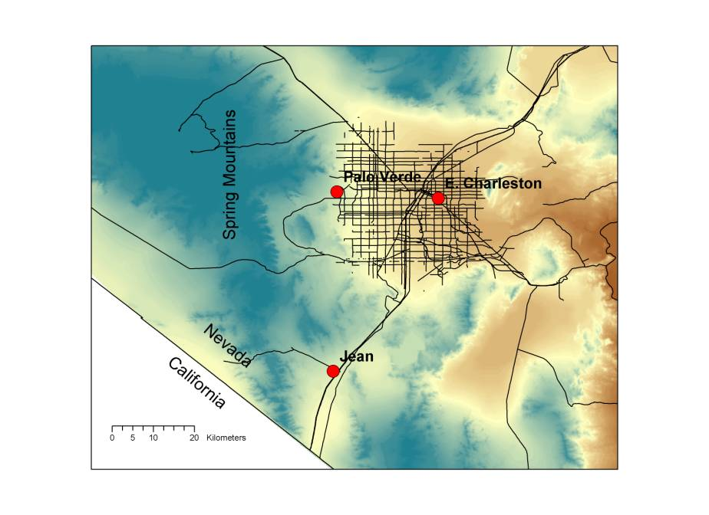
Locations of monitoring stations

Slide 12
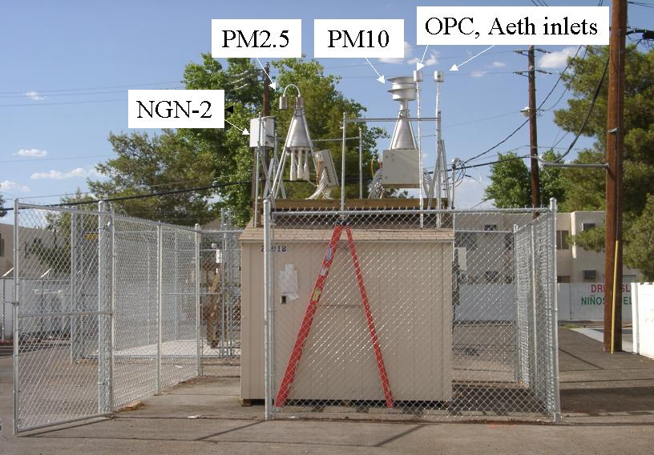
East Charleston site

Slide 13
Results of PM2.5 chemical analysis
Summarized for major components:
Soil or crustal mainly from construction activity, disturbed vacant land, road dust
Organic carbon mainly from vehicles, some from burning, vegetation, cooking, etc.
Elemental carbon mainly from vehicles (especially on and off-road diesel), burning
Sulfates from combustion of sulfur containing fuels (i.e. coal, a little in gasoline and diesel fuel)
Nitrates from combustion- e.g. vehicles, powerplants

Slide 14
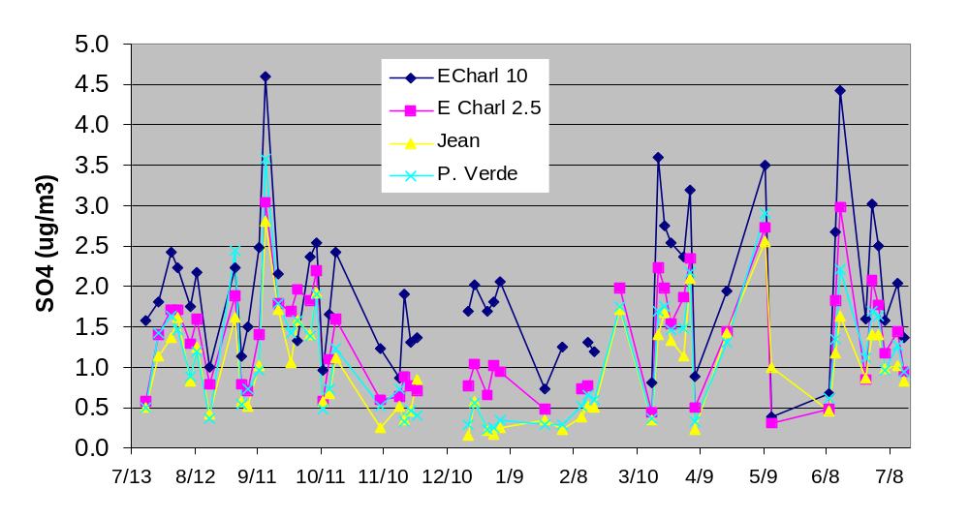
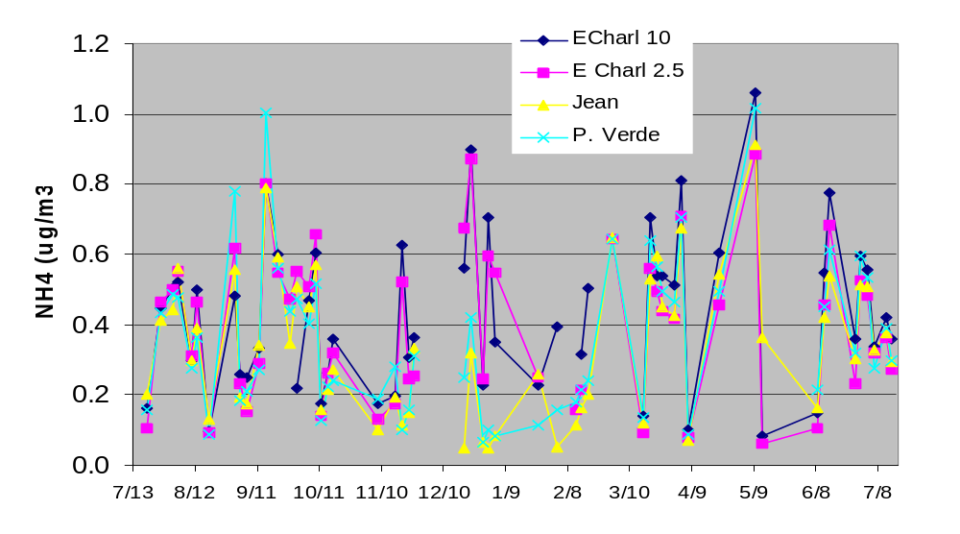
Sulfate well correlated all sites, regional in nature, little local contribution
NH₄ well correlated when sulfate is, less in winter when more NO₃ is present

Slide 15
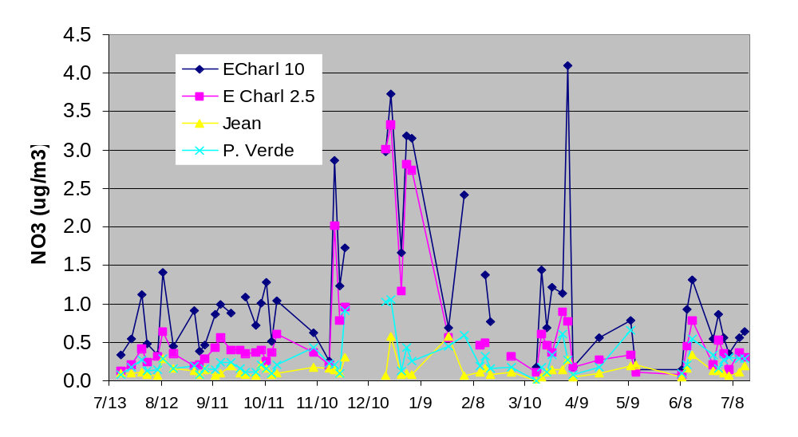
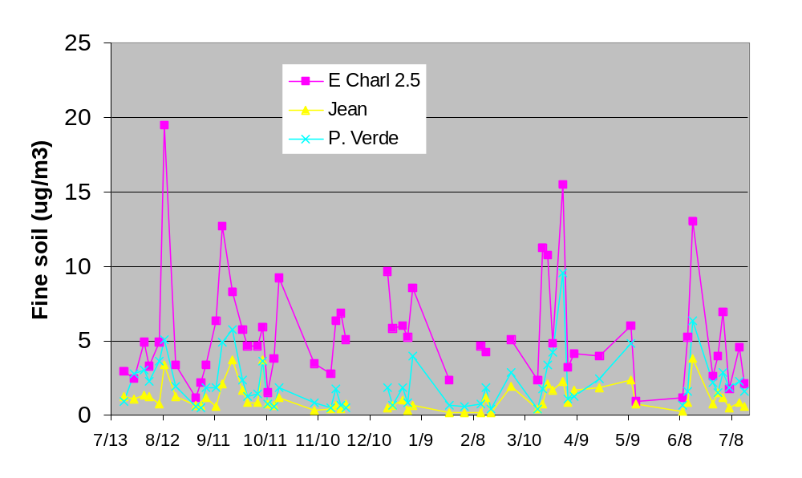
Fine Nitrate low except some winter cases in urban area
Fine soil somewhat correlated, much higher in urban area

Slide 16
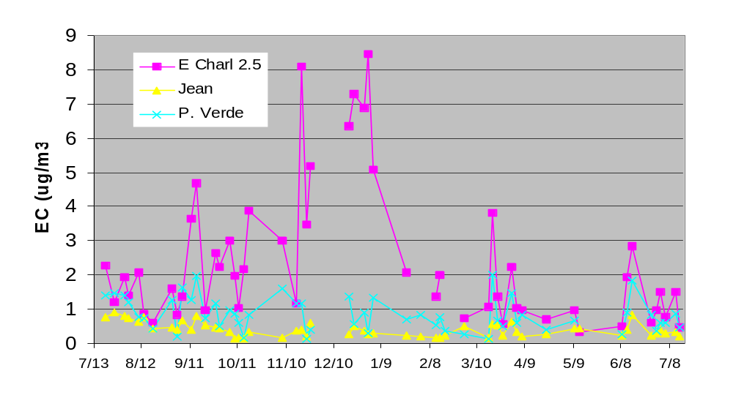
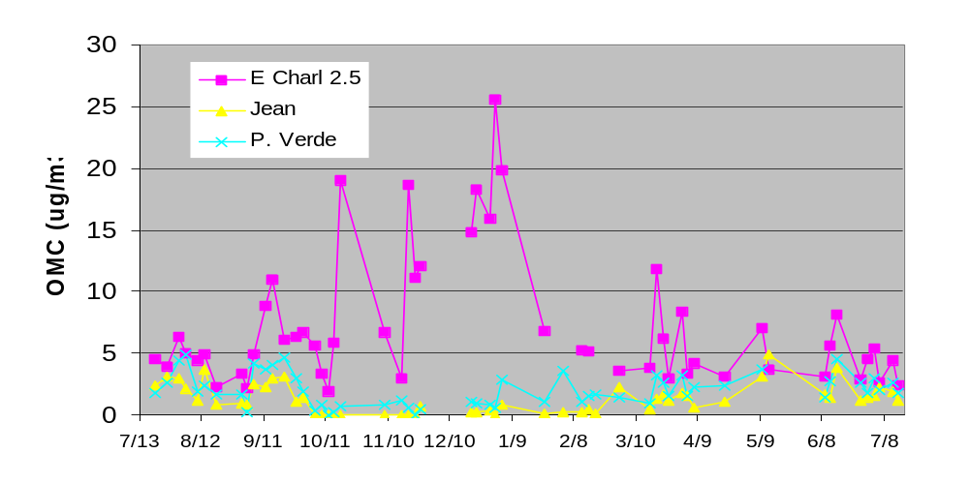
Elemental and organic carbon much higher at urban site, especially in winter

Slide 17
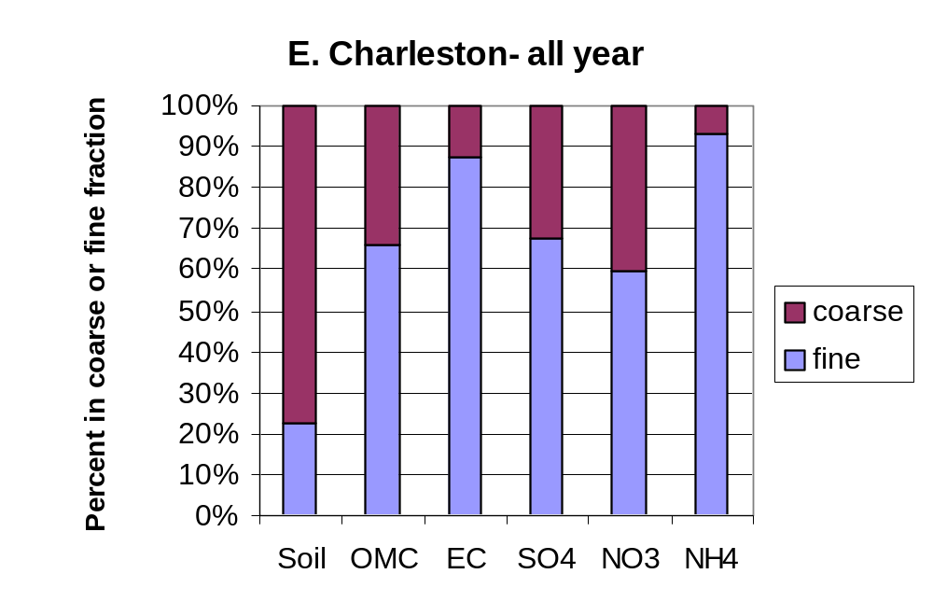
Most soil coarse, most EC, NH4 fine- OMC,SO4, NO3 about 2/3 fine
Fine=<2.5 μm, coarse=2.5-10 μ m

Slide 18
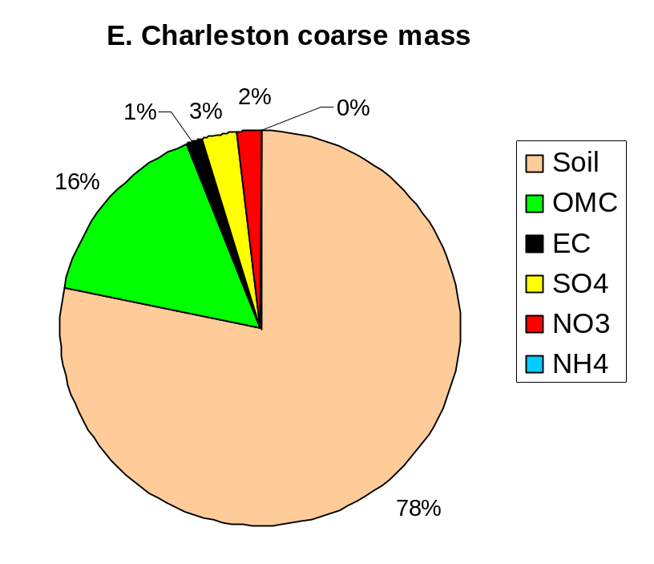
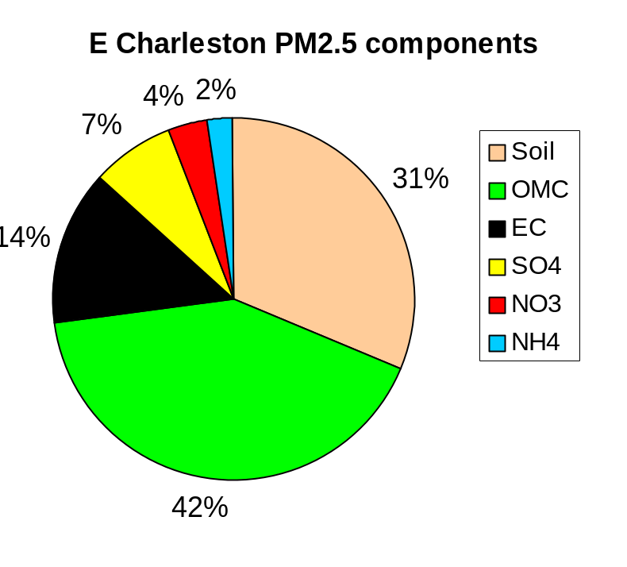
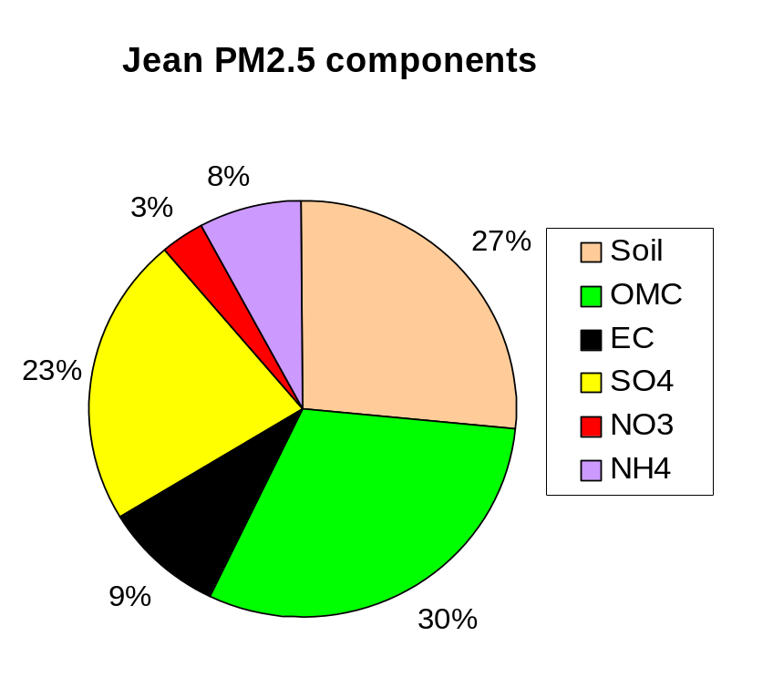
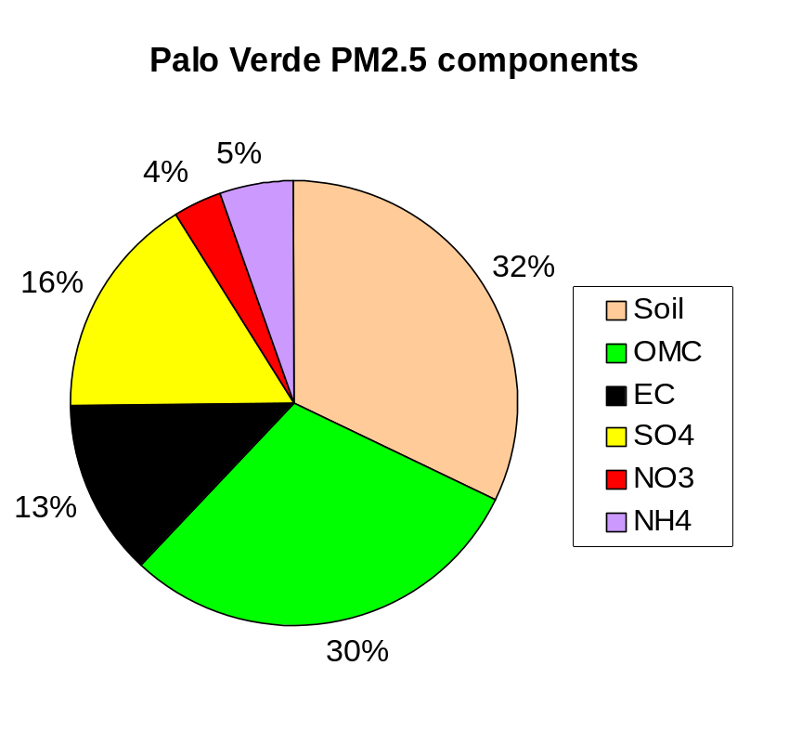

Slide 19
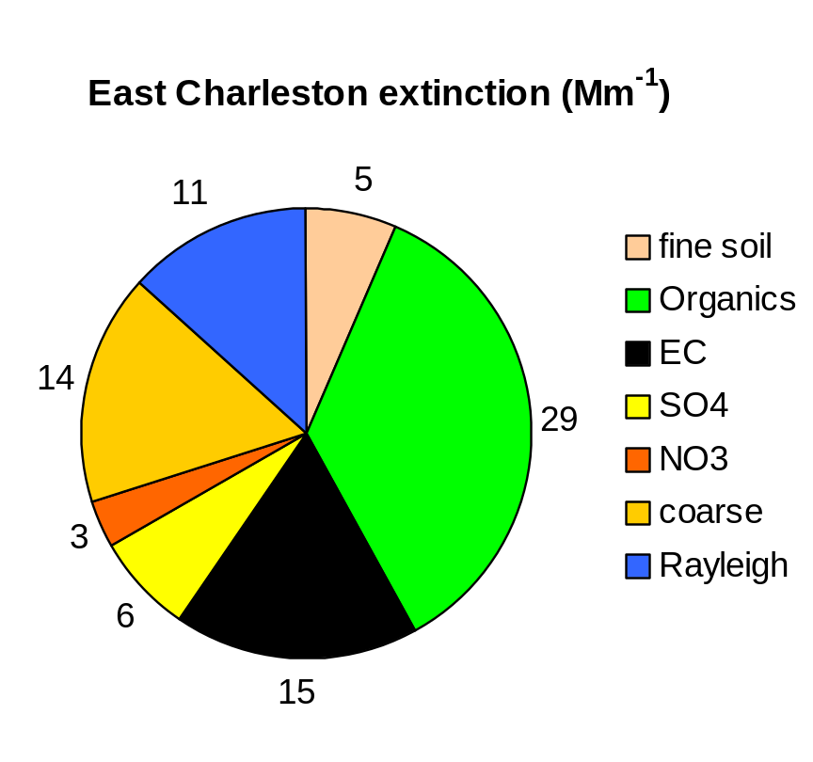
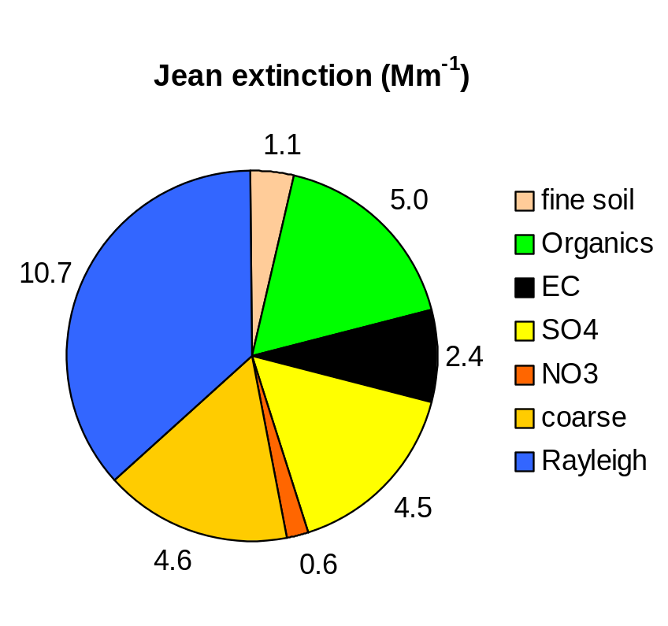
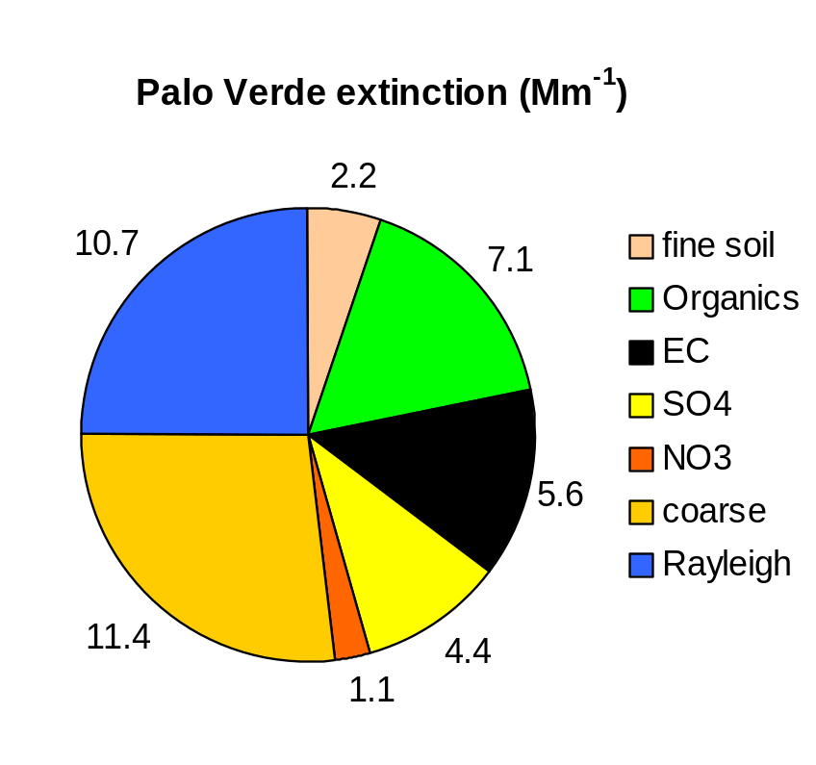

Slide 20
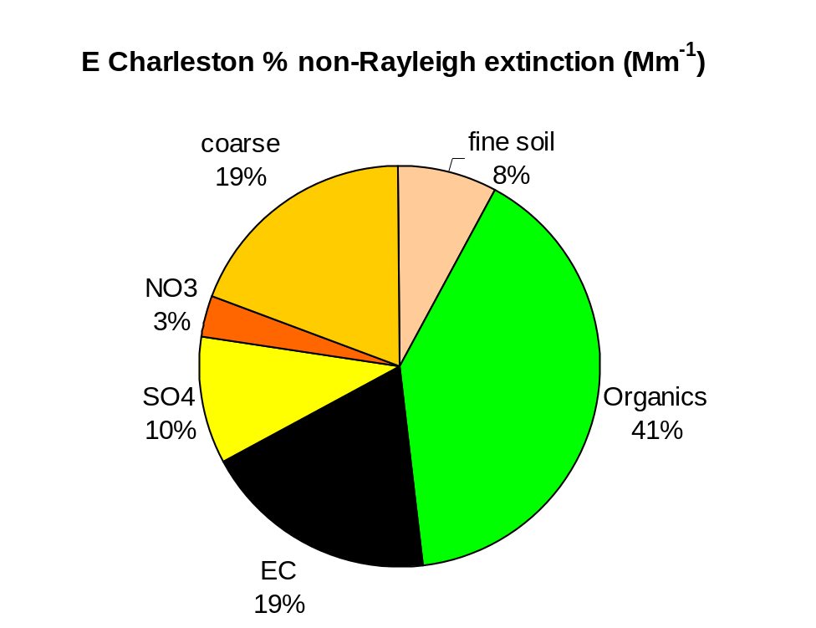
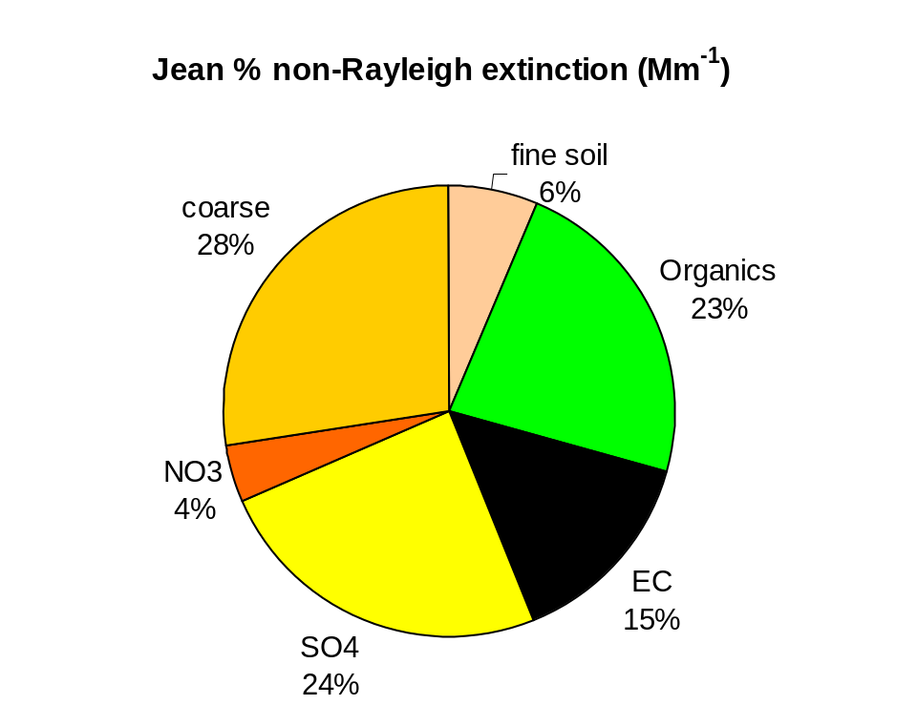
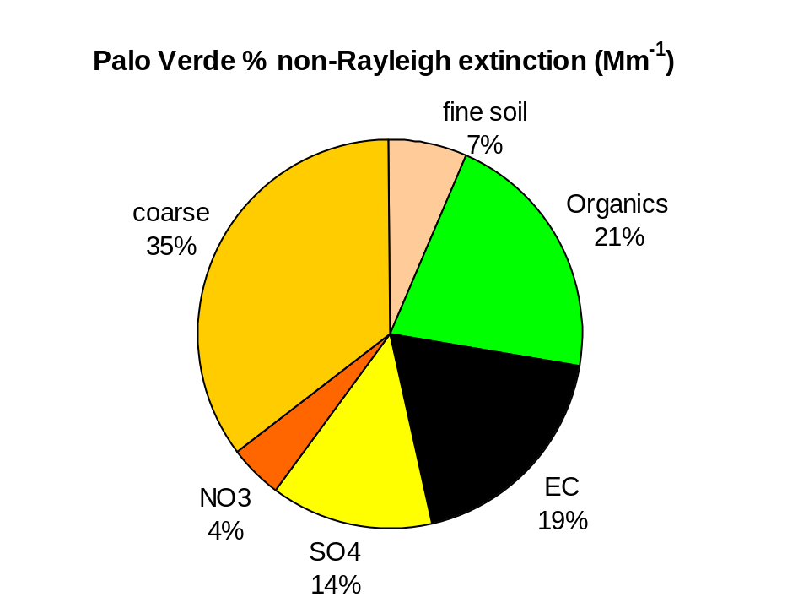

Slide 21
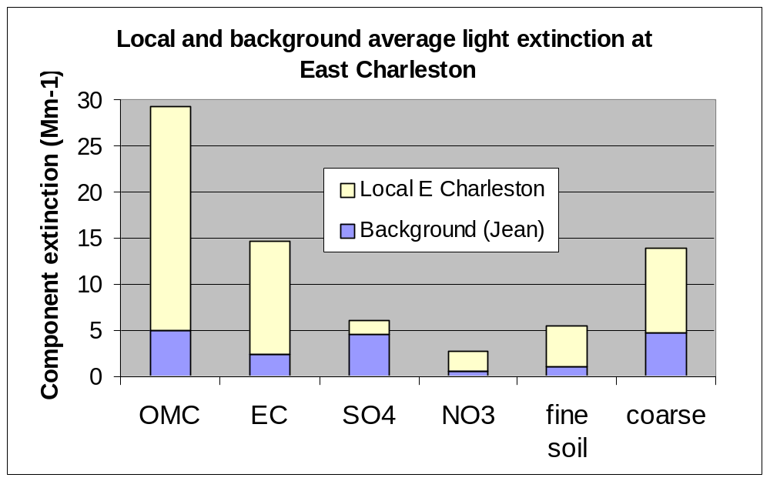
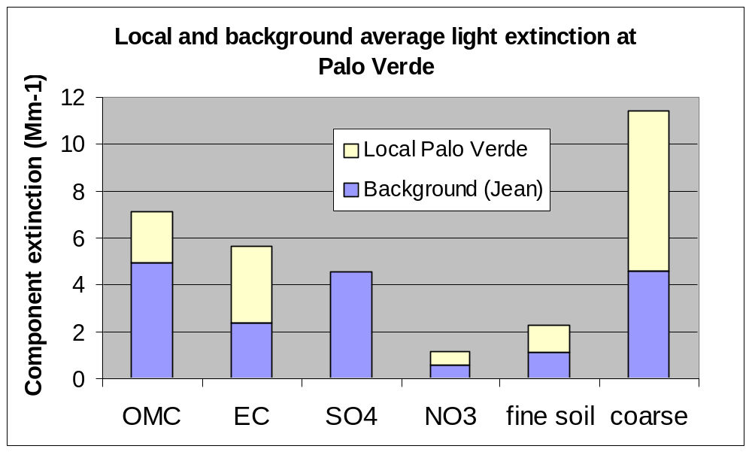
Sulfate haze regional in nature, relatively small at urban site
Crustal and carbon haze large at urban and suburban sites, mainly locally produced

Slide 22
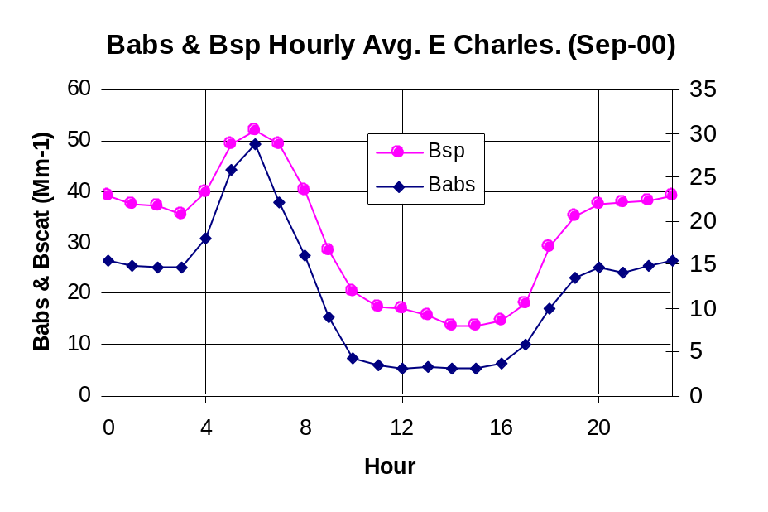
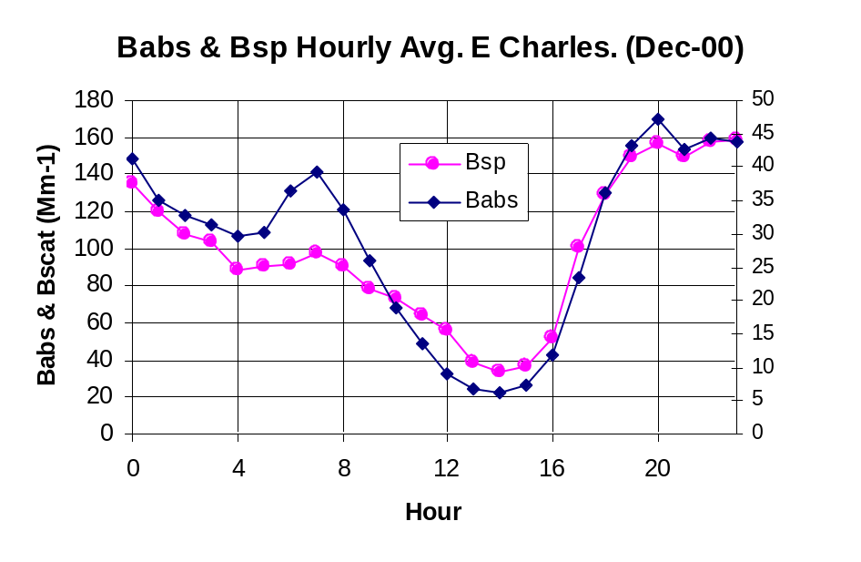
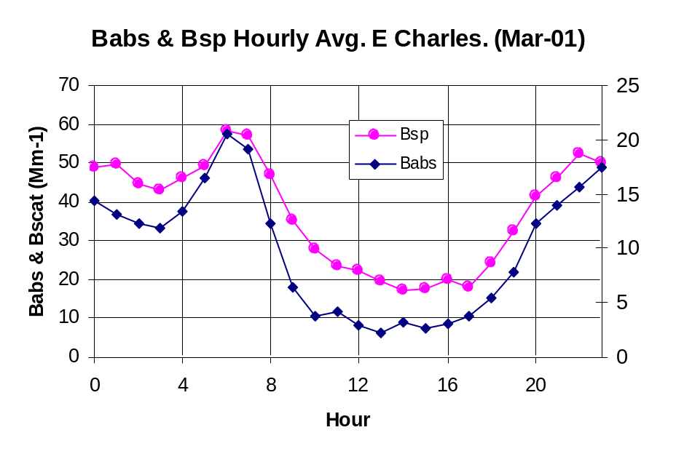
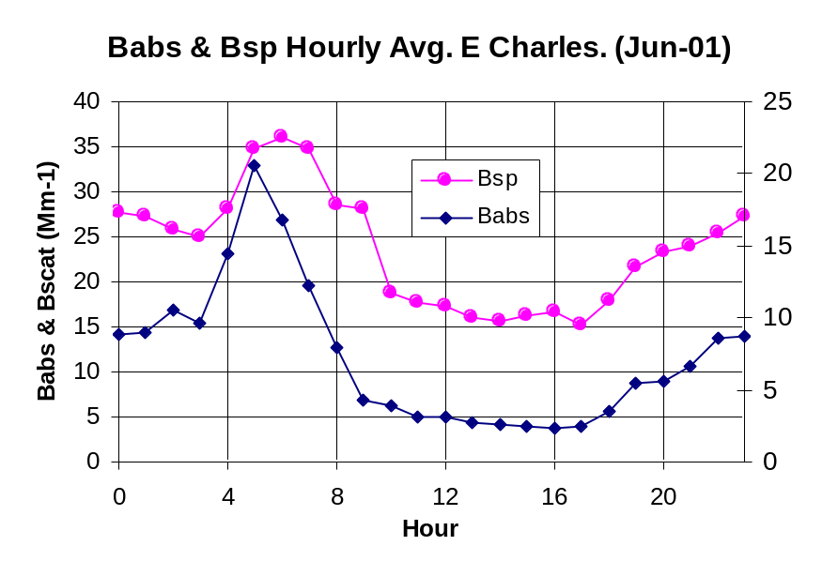
Diurnal patterns in scattering and absorption
by season at E Charleston

Slide 23
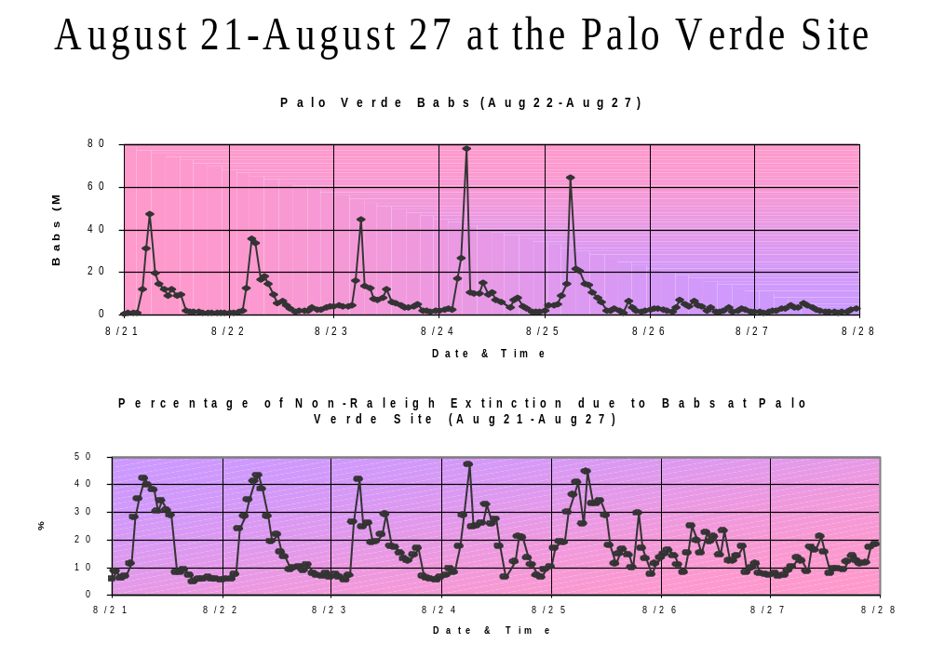
Construction equipment effects

Slide 24
Conclusions
About 45-75% of haze in Las Vegas Valley locally generated
Significant short-term impacts from blowing dust and diesel emissions on occasion
Crustal material and organic and elemental carbon dominate locally produced haze
Crustal source contributions reasonably well known- construction activity, disturbed vacant land, road dust
Additional work needed to attribute carbon to source categories- e.g. gasoline and diesel on-road vehicles, construction equipment, meat cooking, etc.
Possible regional haze effects from Las Vegas urban area at Zion, Grand Canyon National Parks must be addressed

Slide 25
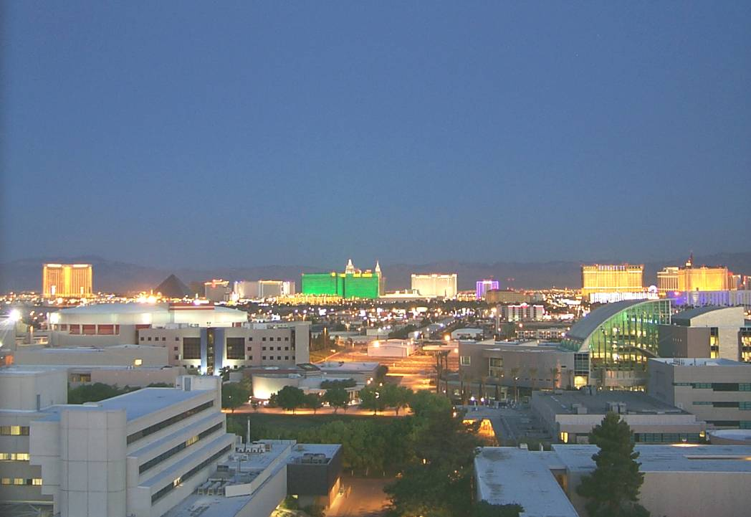
Thanks to:
Arsineh Hecobian, Hampden Kuhns, Vic Etyemezian, Judy Chow, John Watson, DRI
Femi Durosinmi, Dennis Ransel, Will Cates, Christine Robinson, Clark County Dept. of Air Quality Management

Slide 26
